Slide 1
Frederick National Laboratory for Cancer Research
Presenter Title, Affiliation
Date 1, 2018

Slide 2
Frederick National Laboratory HQ Advanced Technology Research Facility
Focus on cancer, AIDS, rapid response to emerging infectious diseases
Basic, translational, preclinical science; technology development
Provide access to advanced technologies, expertise, collaboration, partnerships
Biopharmaceutical development, production; clinical trials support internationally

Slide 3
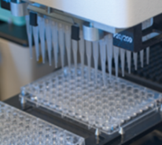
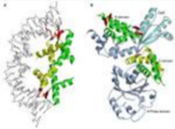
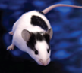
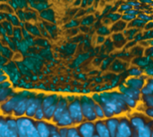
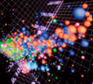
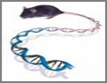
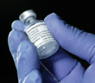
Scientific Expertise and Technologies
Genetics and Genomics
Proteins and Proteomics
Integrated in vivo Services
Imaging and Nanotechnology
Advanced Biomedical Computing
Laboratory Animal Sciences
Biopharmaceutical Development

Slide 4
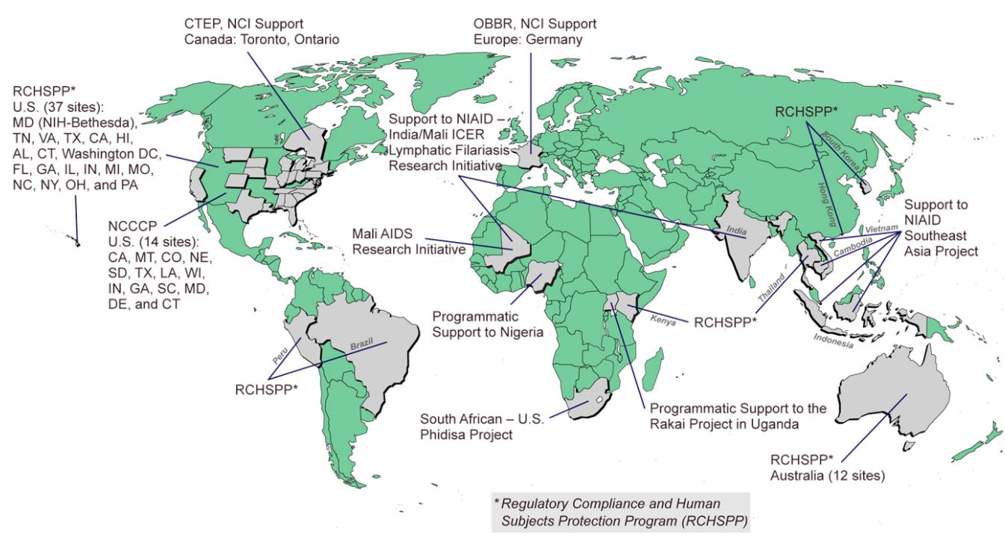
Frederick National Laboratory Global

Slide 5
Scientific Highlights
FDA-approved drug for childhood cancer, pediatric neuroblastoma (ch14.18)
RAS cancers – protein/membrane complex
Zika, Ebola – NIAID-funded vaccine production, trials
Nanotechnology – with Amgen AstraZeneca, Pfizer, others
HPV serology lab, dose study 3-to-2, oral protection
NCI-DOE partnership – ATOM to speed preclinical drug development
Cryo-electron microscopy, shared facility – near atomic resolution
Instrumental role in protecting nation’s blood supply from HIV (1980s)

Slide 6
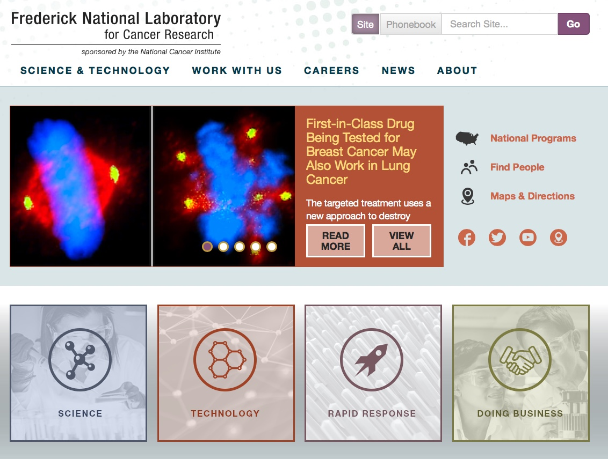
frederick.cancer.gov

